Slide 1

AGB1211 – DESIGN THINKING
Department of Artificial Intelligence and Data Science
Academic Year: 2024 – 2025 (Odd Semester)
Year : II YEAR
Semester : 3rd
Section :A
Date :05.12.2024
PRESENTED BY
BALARUBAN R
2. BHAVAN SABARI S
3. DARRUNSITASH M
4. DHINESH M
AGB1211 – DESIGN THINKING

Slide 2
Title of the Project
HEALTH MONITORING APPLICATION
AGB1211 – DESIGN THINKING

Slide 3
Problem Identification
Lack of Motivational Features:
Health monitoring applications often lack engaging tools like gamification, reminders, or progress tracking to encourage consistent user engagement and adherence to healthy habits.
Lack of Personalization:
Generic health insights fail to cater to individual needs, preferences, or specific medical conditions, reducing the effectiveness of the application for diverse users.
User-Friendliness and Accessibility:
Complex interfaces and lack of inclusivity hinder usability, particularly for elderly or technologically inexperienced users, limiting widespread adoption and satisfaction.
Lack of Integration and Accessibility:
Challenges in syncing health data with healthcare providers or systems and limited functionality in areas with poor internet connectivity restrict the application's utility.
AGB1211 – DESIGN THINKING

Slide 4
Objective
The objective of this Health monitoring application is to provide users with a seamless platform to monitor their health and wellness journey. By integrating features like activity tracking, personalized reminders, workout management, and progress monitoring, the app aims to motivate users to stay consistent with their fitness goals. Its user-friendly design ensures easy navigation between features such as Profile, Dashboard, My Progress, and Notifications, making it a centralized and accessible solution for maintaining a healthy lifestyle.
AGB1211 – DESIGN THINKING

Slide 5
BrainStorming
Health
Fitness
Wellness
Tracking
Dashboard
Progress
Goals
Reminder
Notification
Workout
Personalization
Motivation
Accessibility
User-Friendly
Activity
Engagement
Integration
Lifestyle
Innovation
Simplicity
AGB1211 – DESIGN THINKING

Slide 6
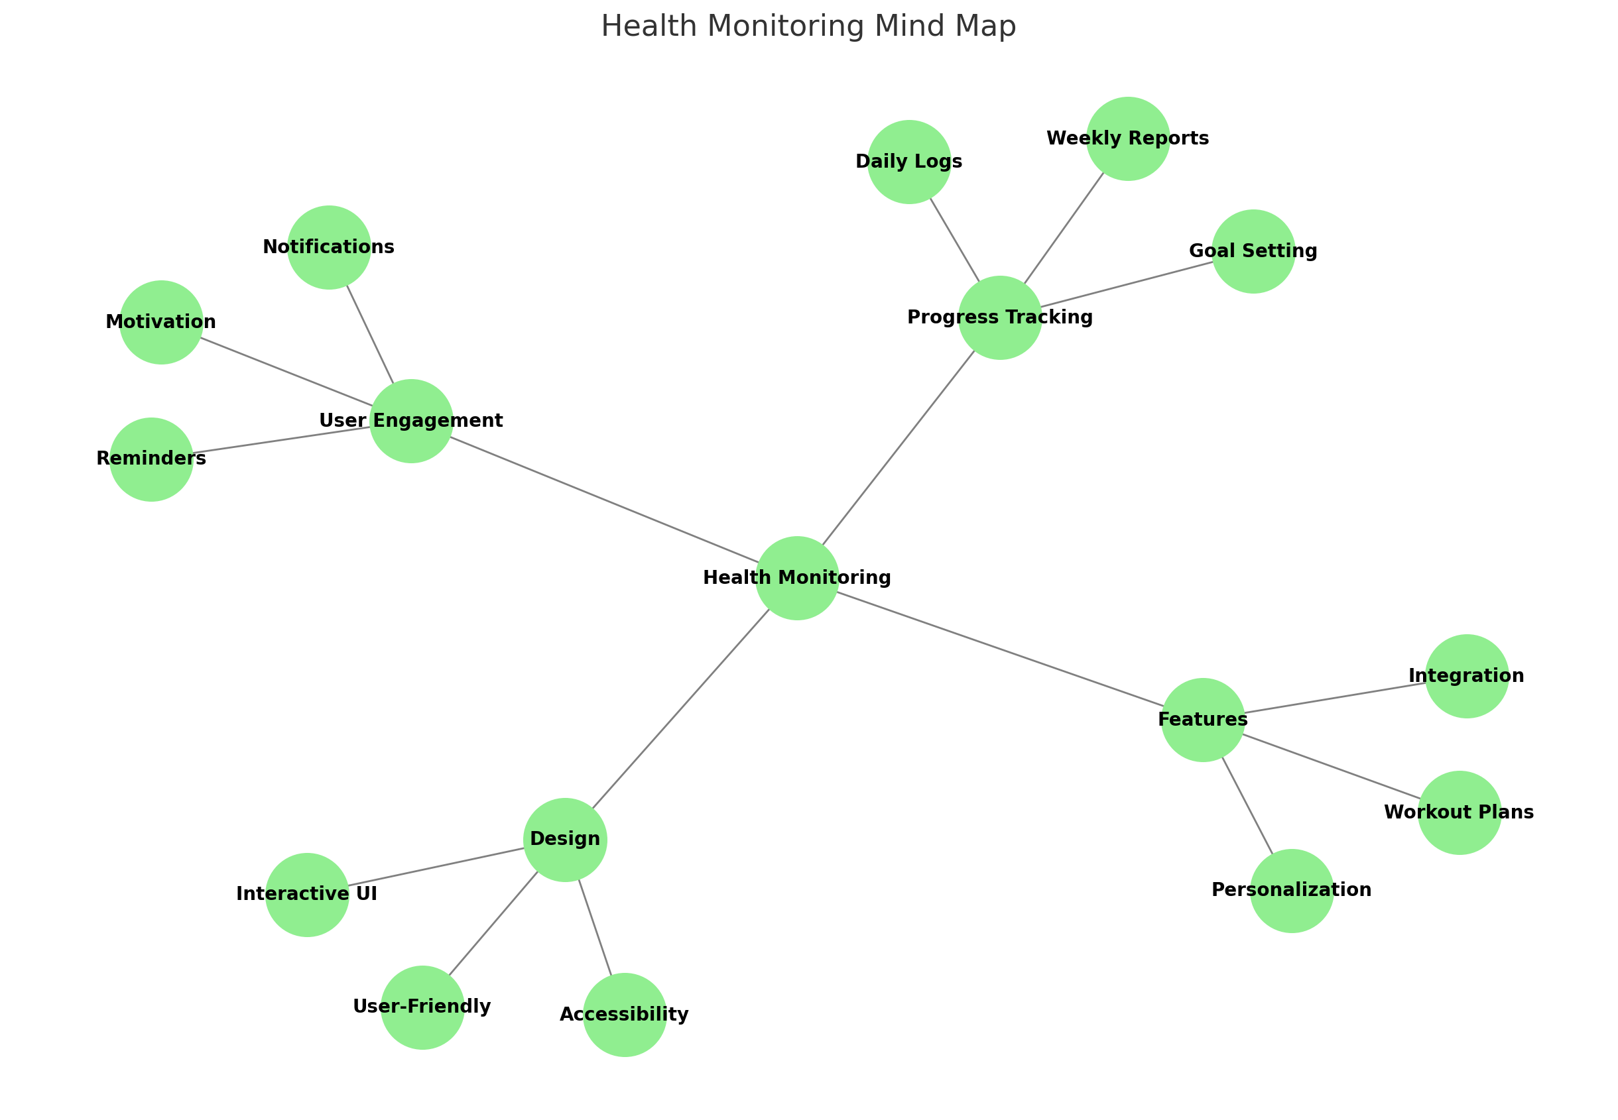
Mind Map
AGB1211 – DESIGN THINKING

Slide 7
Primary Research
Surveys and Questionnaires:
Conduct surveys with target users to gather insights about their health monitoring needs, preferences, and challenges.
Include specific questions on usability, desired features, and concerns like privacy or data accuracy.
Interviews:
Speak with potential users (e.g., patients, fitness enthusiasts, or the elderly) and healthcare professionals to understand expectations and limitations of existing apps.
Focus on their experiences with similar technologies and suggestions for improvement.
Focus Groups:
Organize group discussions to explore user behavior, pain points, and potential motivators for consistent app usage.
Observational Studies:
Observe how users interact with health monitoring apps in real-life scenarios to identify usability gaps or frustrations
AGB1211 – DESIGN THINKING

Slide 8
Secondary Research
Market Analysis:
Study existing health monitoring apps to analyze their features, pricing, user ratings, and market positioning.
Identify gaps that your app can address, such as personalization or integration with medical systems.
Academic Research:
Review studies on user behavior, health outcomes, and technology adoption related to health monitoring devices and applications.
Focus on issues like data accuracy, privacy concerns, and the impact of motivational features.
Competitor Analysis:
Examine competitors’ strengths and weaknesses, particularly in areas like personalization, user experience, and integration with wearables or healthcare systems.
Identify opportunities to differentiate your app.
Technological Research:
Investigate advancements in wearable technology, AI, and IoT relevant to health monitoring.
Explore innovative features like predictive analytics or machine learning for personalized health recommendations.
AGB1211 – DESIGN THINKING

Slide 9
Proposed Work
The proposed work for the health monitoring application focuses on addressing gaps in existing solutions by implementing features like real-time health tracking, personalized reminders, progress visualization, and a user-friendly interface. Tools such as Figma, Adalo, and Bubble.io were used to design and develop the application. The application undergoes usability testing and iterative improvements based on feedback, ensuring a seamless user experience before deployment on major platforms.
AGB1211 – DESIGN THINKING

Slide 10
List of Modules
1.User Authentication And Dashboard Module
2.Progress Monitoring Module
3.Notification And Remainder Module
4.Settings and Personalization Module
AGB1211 – DESIGN THINKING

Slide 11
Module 1 Description
User Authentication and Dashboard Module
This module ensures secure access to the application with features like login, signup, and password recovery. User credentials are protected using encryption and authentication protocols. The dashboard provides a centralized view of key health metrics, activity summaries, and updates. It is designed to be visually appealing and user-friendly, displaying information in an organized manner. The module supports session management for a seamless experience. Real-time syncing ensures that users always have the latest data on their dashboard.
AGB1211 – DESIGN THINKING

Slide 12
Module 2 Description
Progress Monitoring Module
The progress monitoring module tracks daily, weekly, and monthly health trends. It provides users with visual insights, such as graphs and charts, to analyze their improvement. Users can set health goals, and the module compares progress against them. The feature motivates users by highlighting achievements and milestones. It integrates with health devices to provide accurate and real-time data. Historical data storage allows for long-term health trend analysis.
AGB1211 – DESIGN THINKING

Slide 13
Module 3 Description
Notification and Reminder Module
This module keeps users engaged with timely alerts and reminders. Notifications inform users about upcoming tasks, such as workouts or medication schedules. Reminders can be personalized based on user preferences, ensuring relevance. Push notifications are integrated for instant updates, even when the app is inactive. The module is designed to be non-intrusive yet effective in driving user engagement. It also allows users to customize the frequency and type of reminders.
AGB1211 – DESIGN THINKING

Slide 14
Module 4 Description
Settings and Personalization Module
This module allows users to tailor the app experience to their preferences. Users can customize notification types, reminder timings, and dashboard layouts. Personal health goals and fitness preferences can be updated within this module. Accessibility features, such as font size adjustment and dark mode, are included. It integrates with third-party devices for a seamless experience. Data privacy settings let users control how their information is shared or used.
AGB1211 – DESIGN THINKING

Slide 15
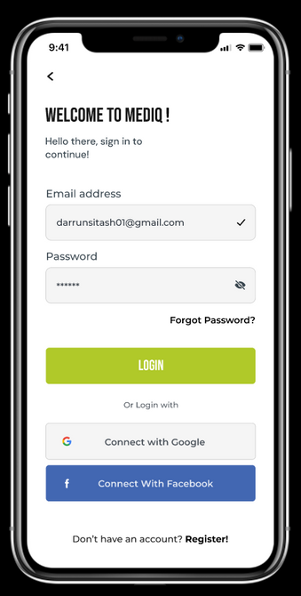
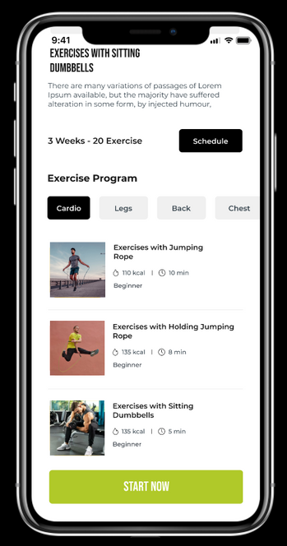
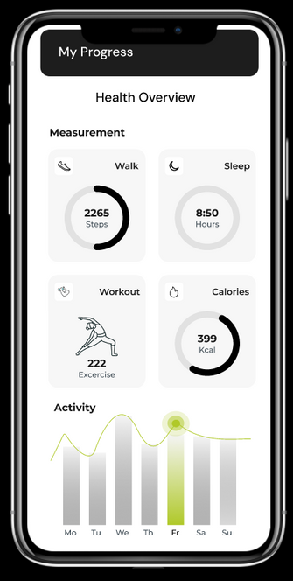
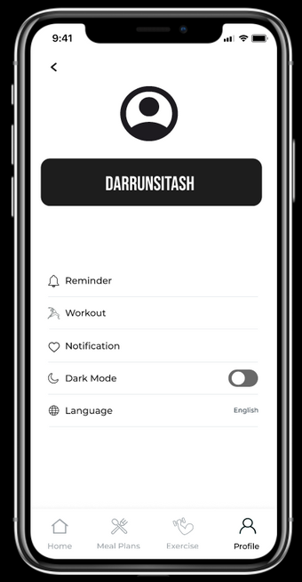
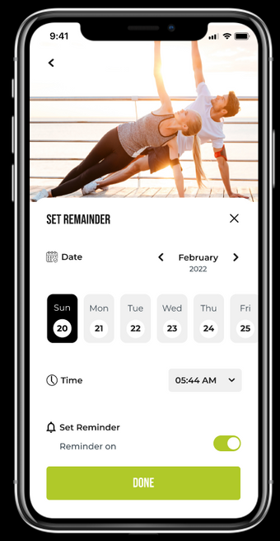
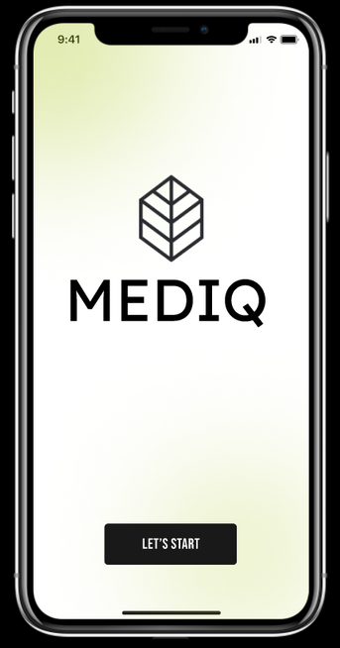
Results
https://www.figma.com/proto/8mfQt3RBppFXRaeBr7aoPR/design-thinking-app?node-id=1-1404&t=vfGPS74w9xLR1P9u-1
AGB1211 – DESIGN THINKING

Slide 16
Conclusion
The health monitoring application is designed to empower users by providing a comprehensive and personalized platform for tracking and improving their well-being. Through secure authentication, intuitive design, and modules like progress monitoring, reminders, and integration with wearable devices, the application ensures an engaging and user-centric experience. Leveraging modern tools like Figma, Adalo, and Bubble.io, it focuses on creating an accessible and efficient solution. This project addresses key gaps in existing health monitoring systems while emphasizing innovation, usability, and long-term value for users.
AGB1211 – DESIGN THINKING

Slide 17
Thank You
ANY QUERIES???
AGB1211 – DESIGN THINKING

